Slide 1





Elva
Social event planning app
Arthur Guiot

Slide 2
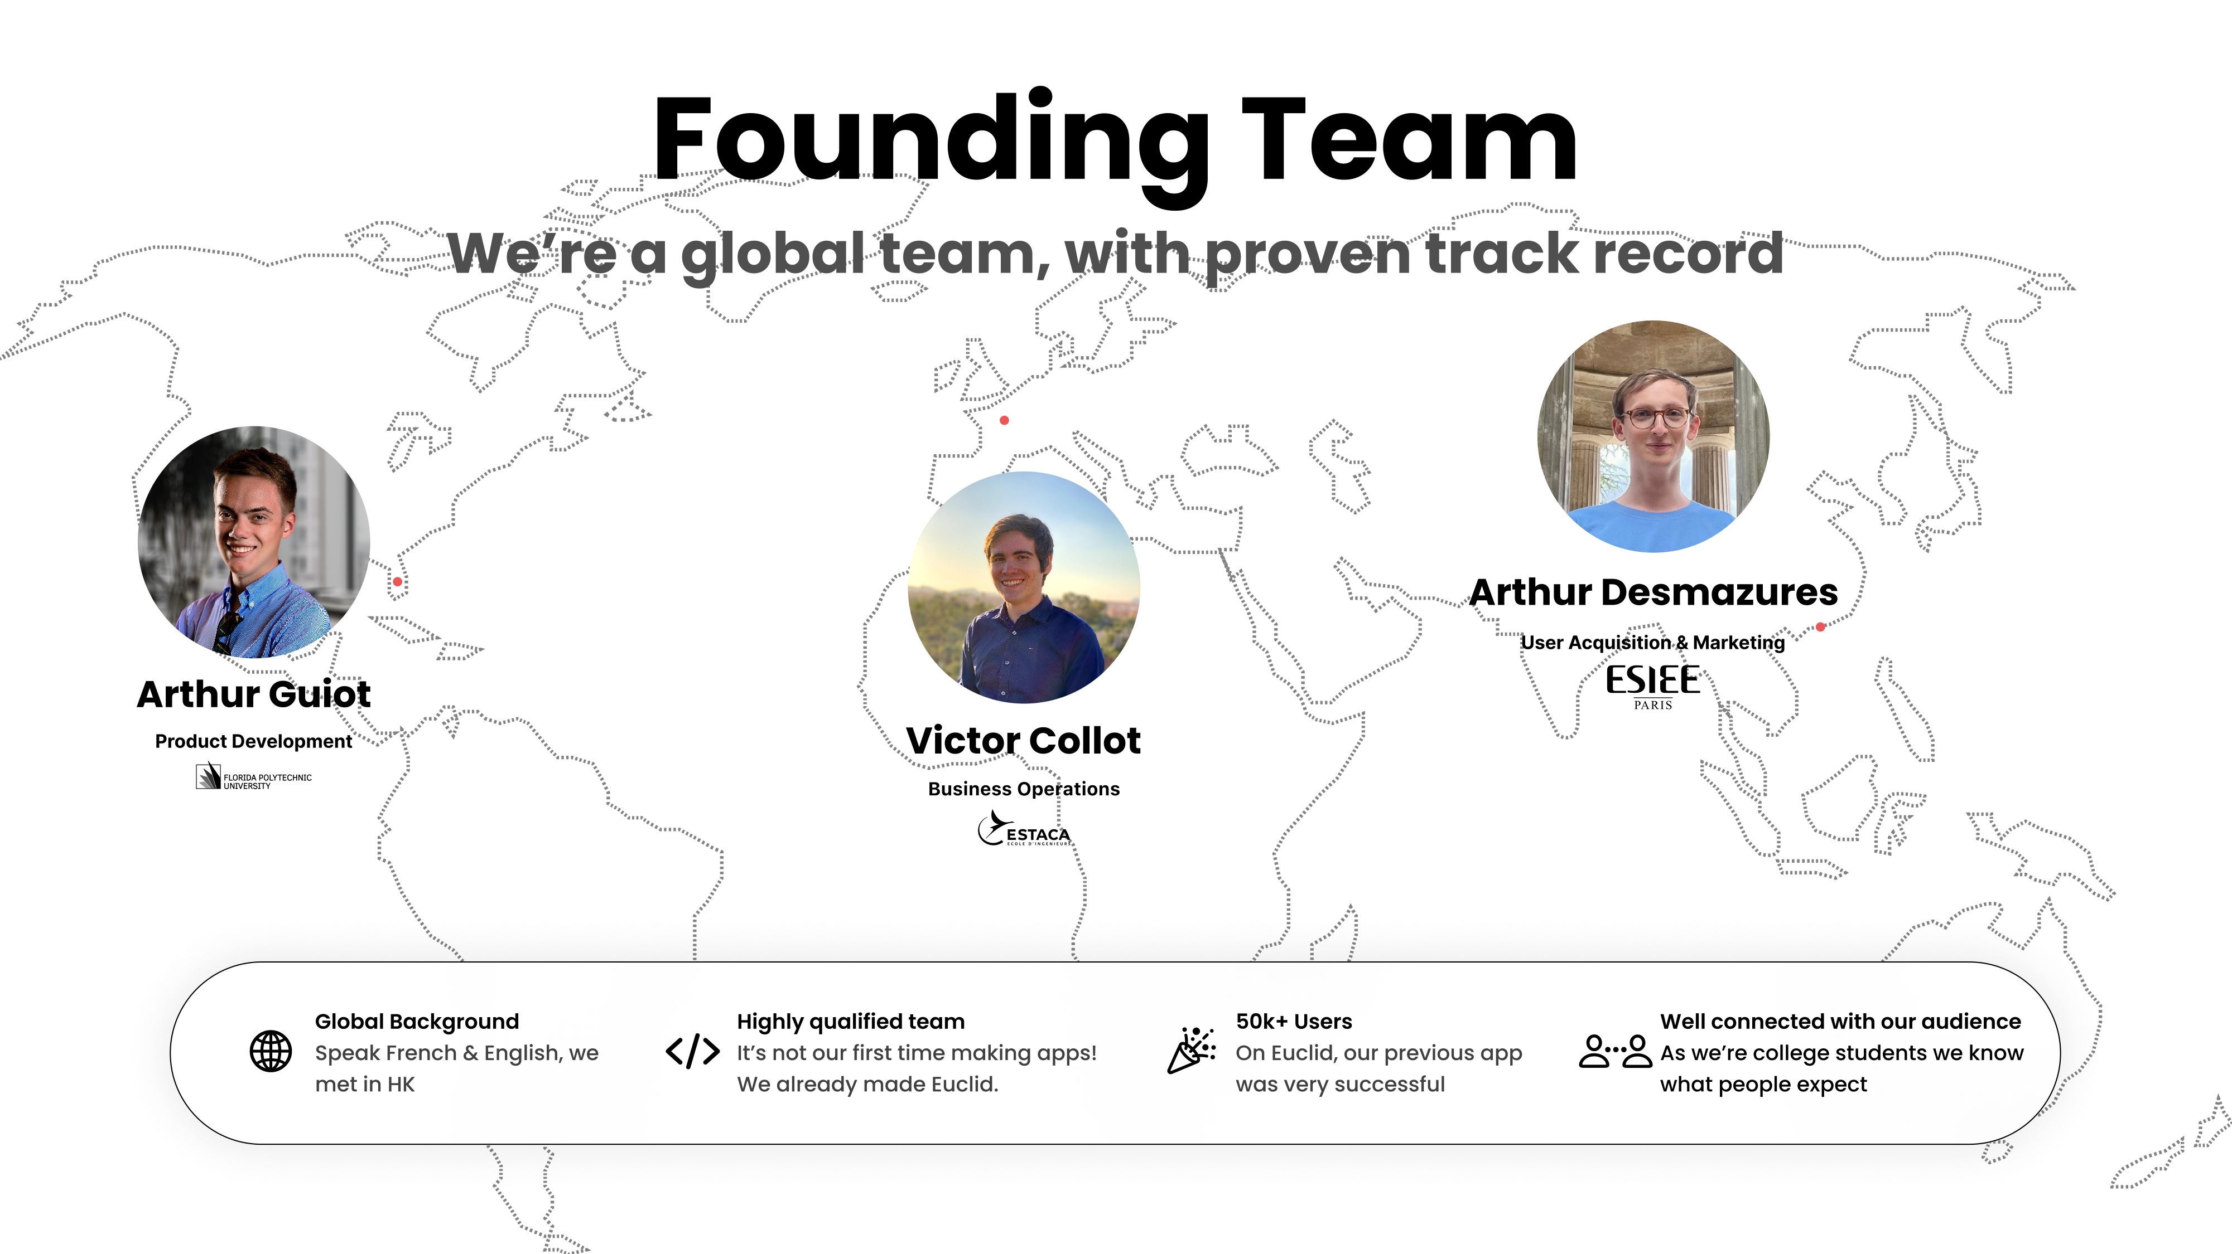

Slide 5
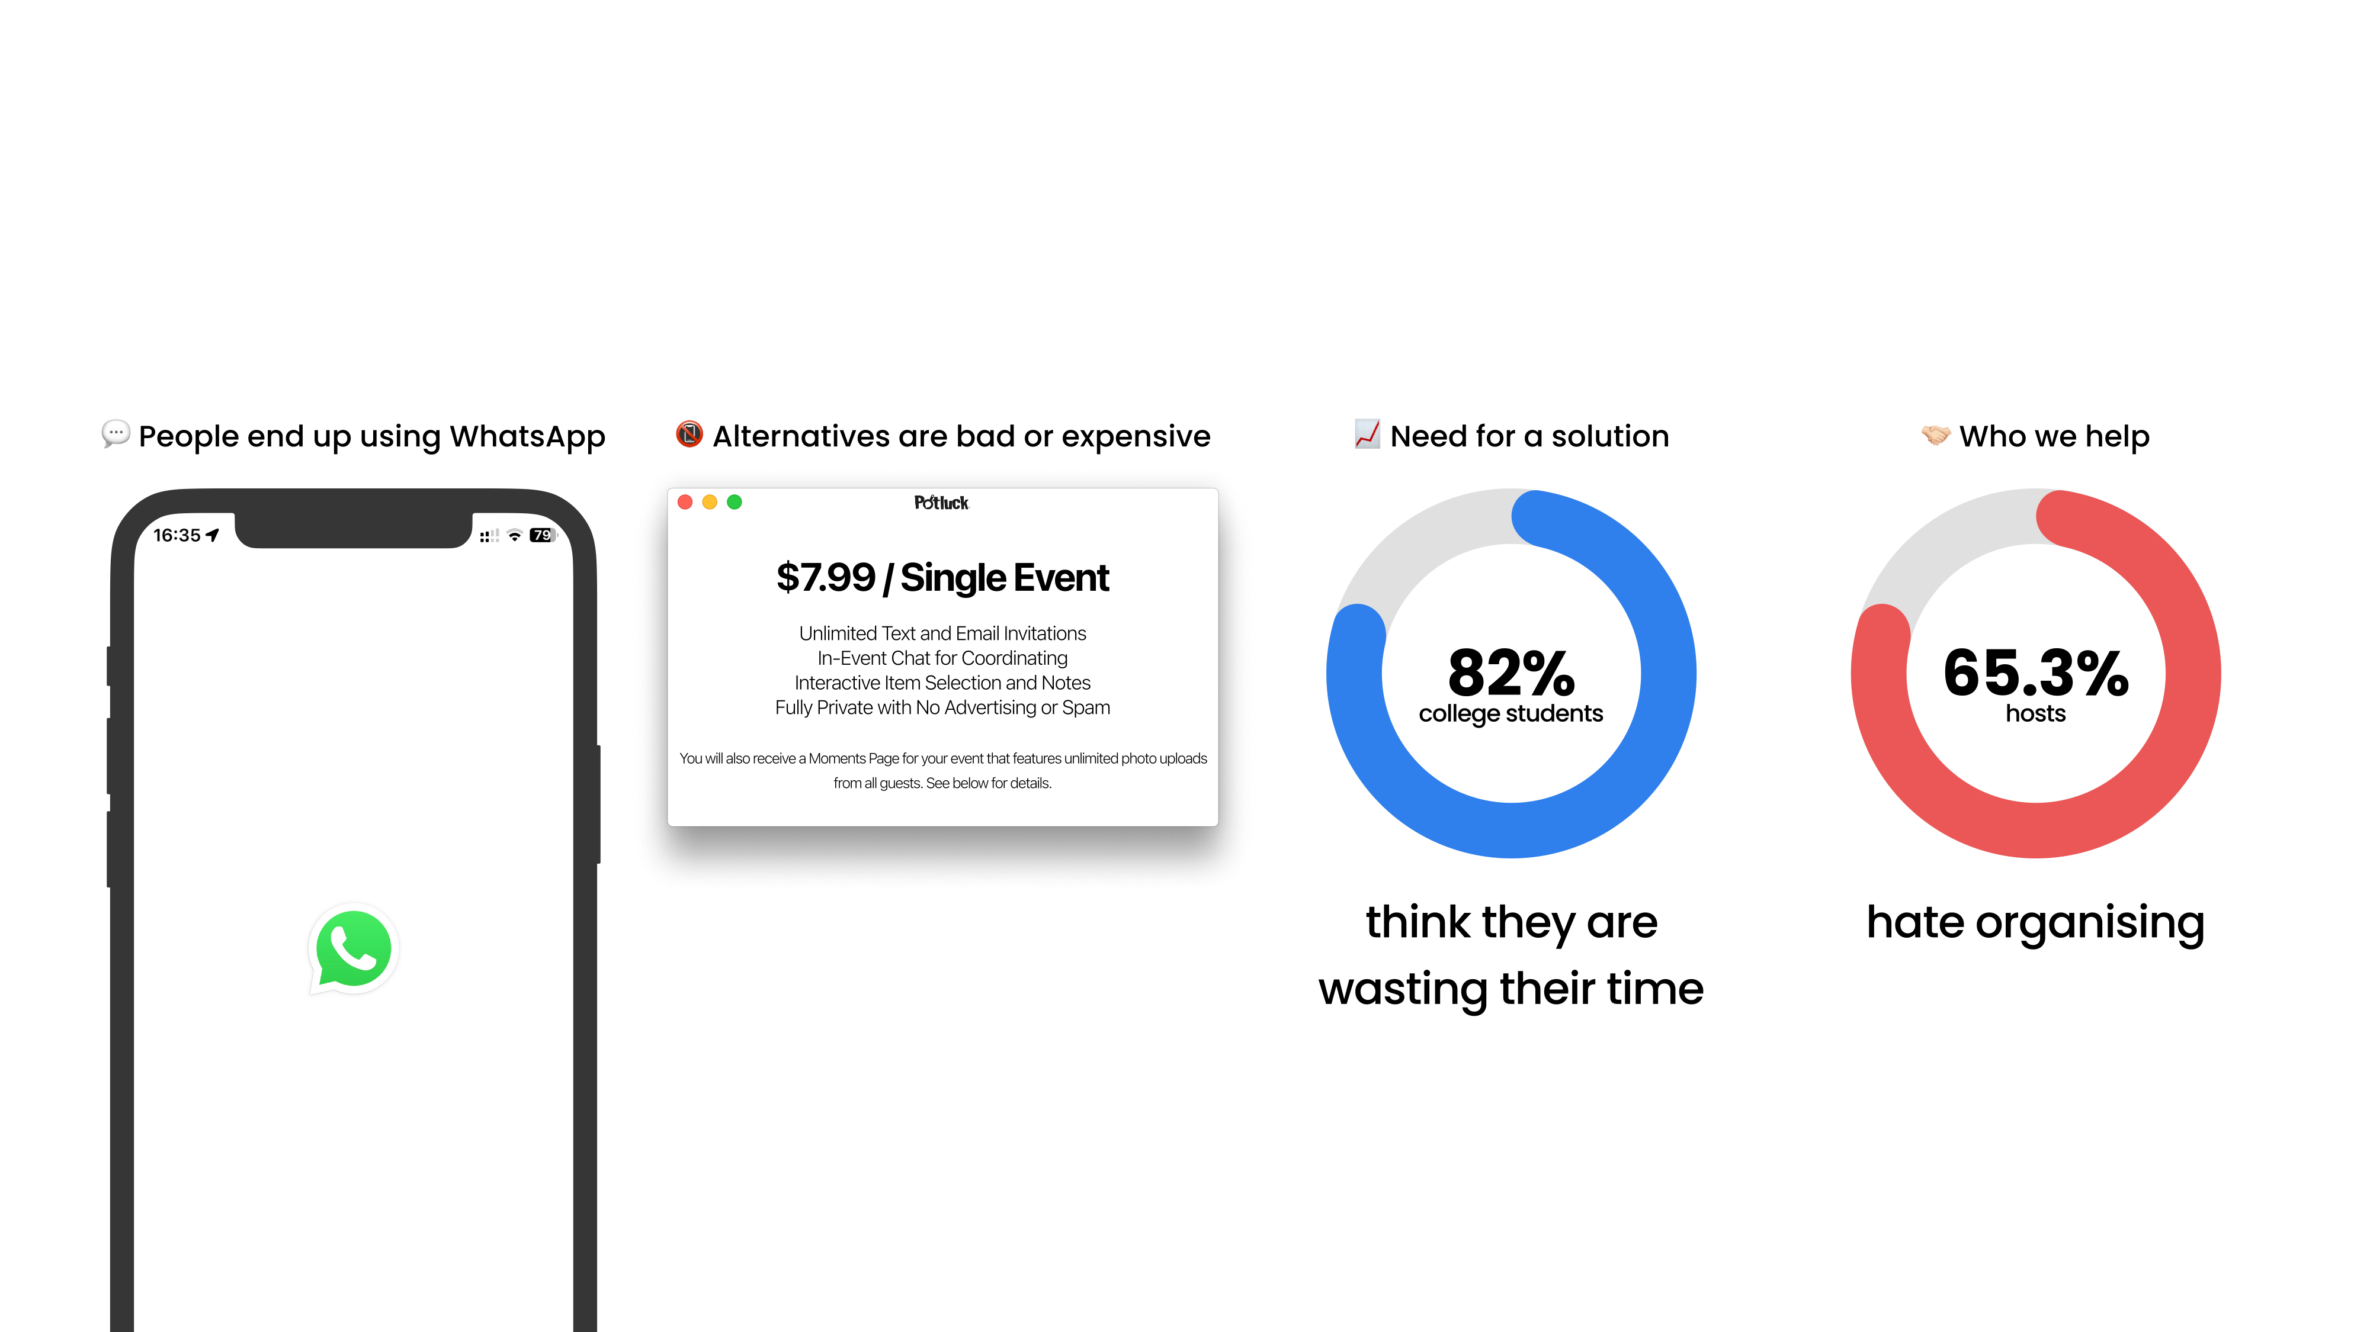
The Problem
Organising good events is hard!

Slide 6


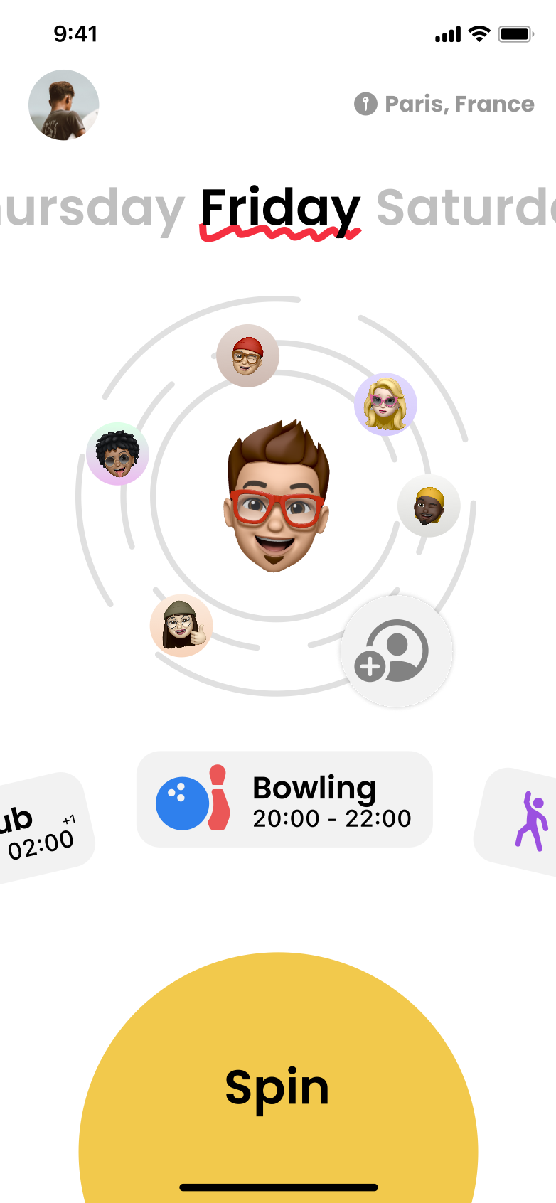
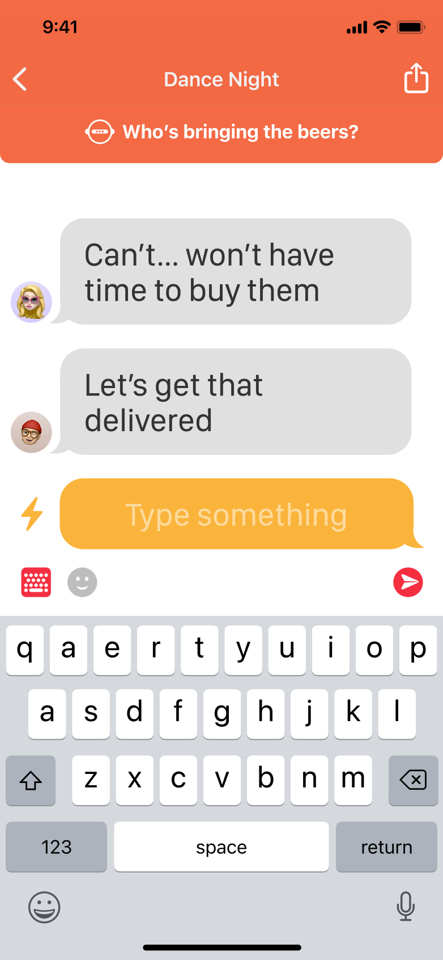
Introducing Elva

Slide 7
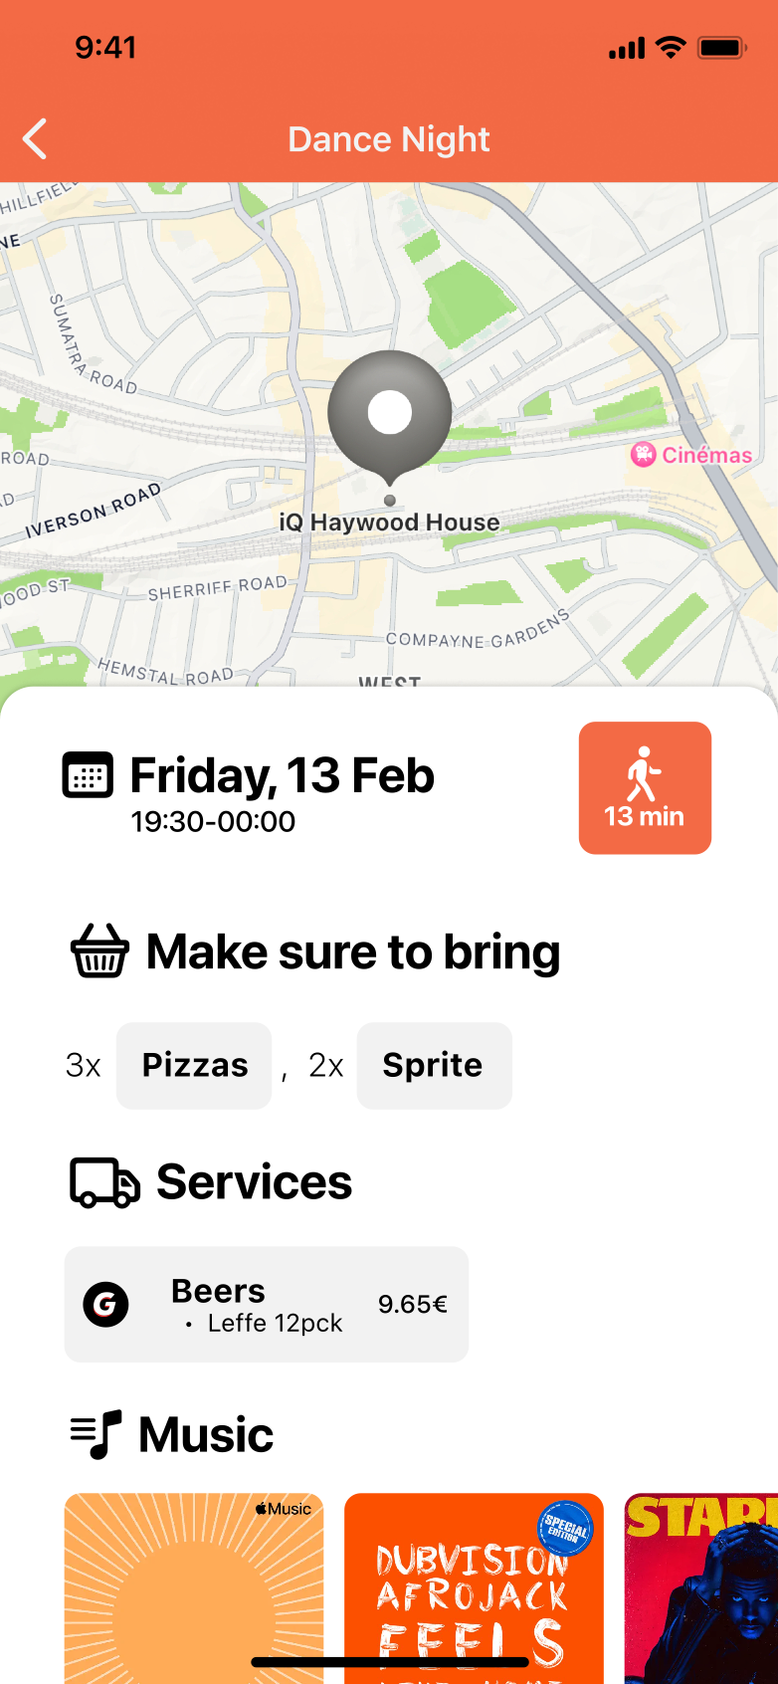
Introducing Elva

Slide 8
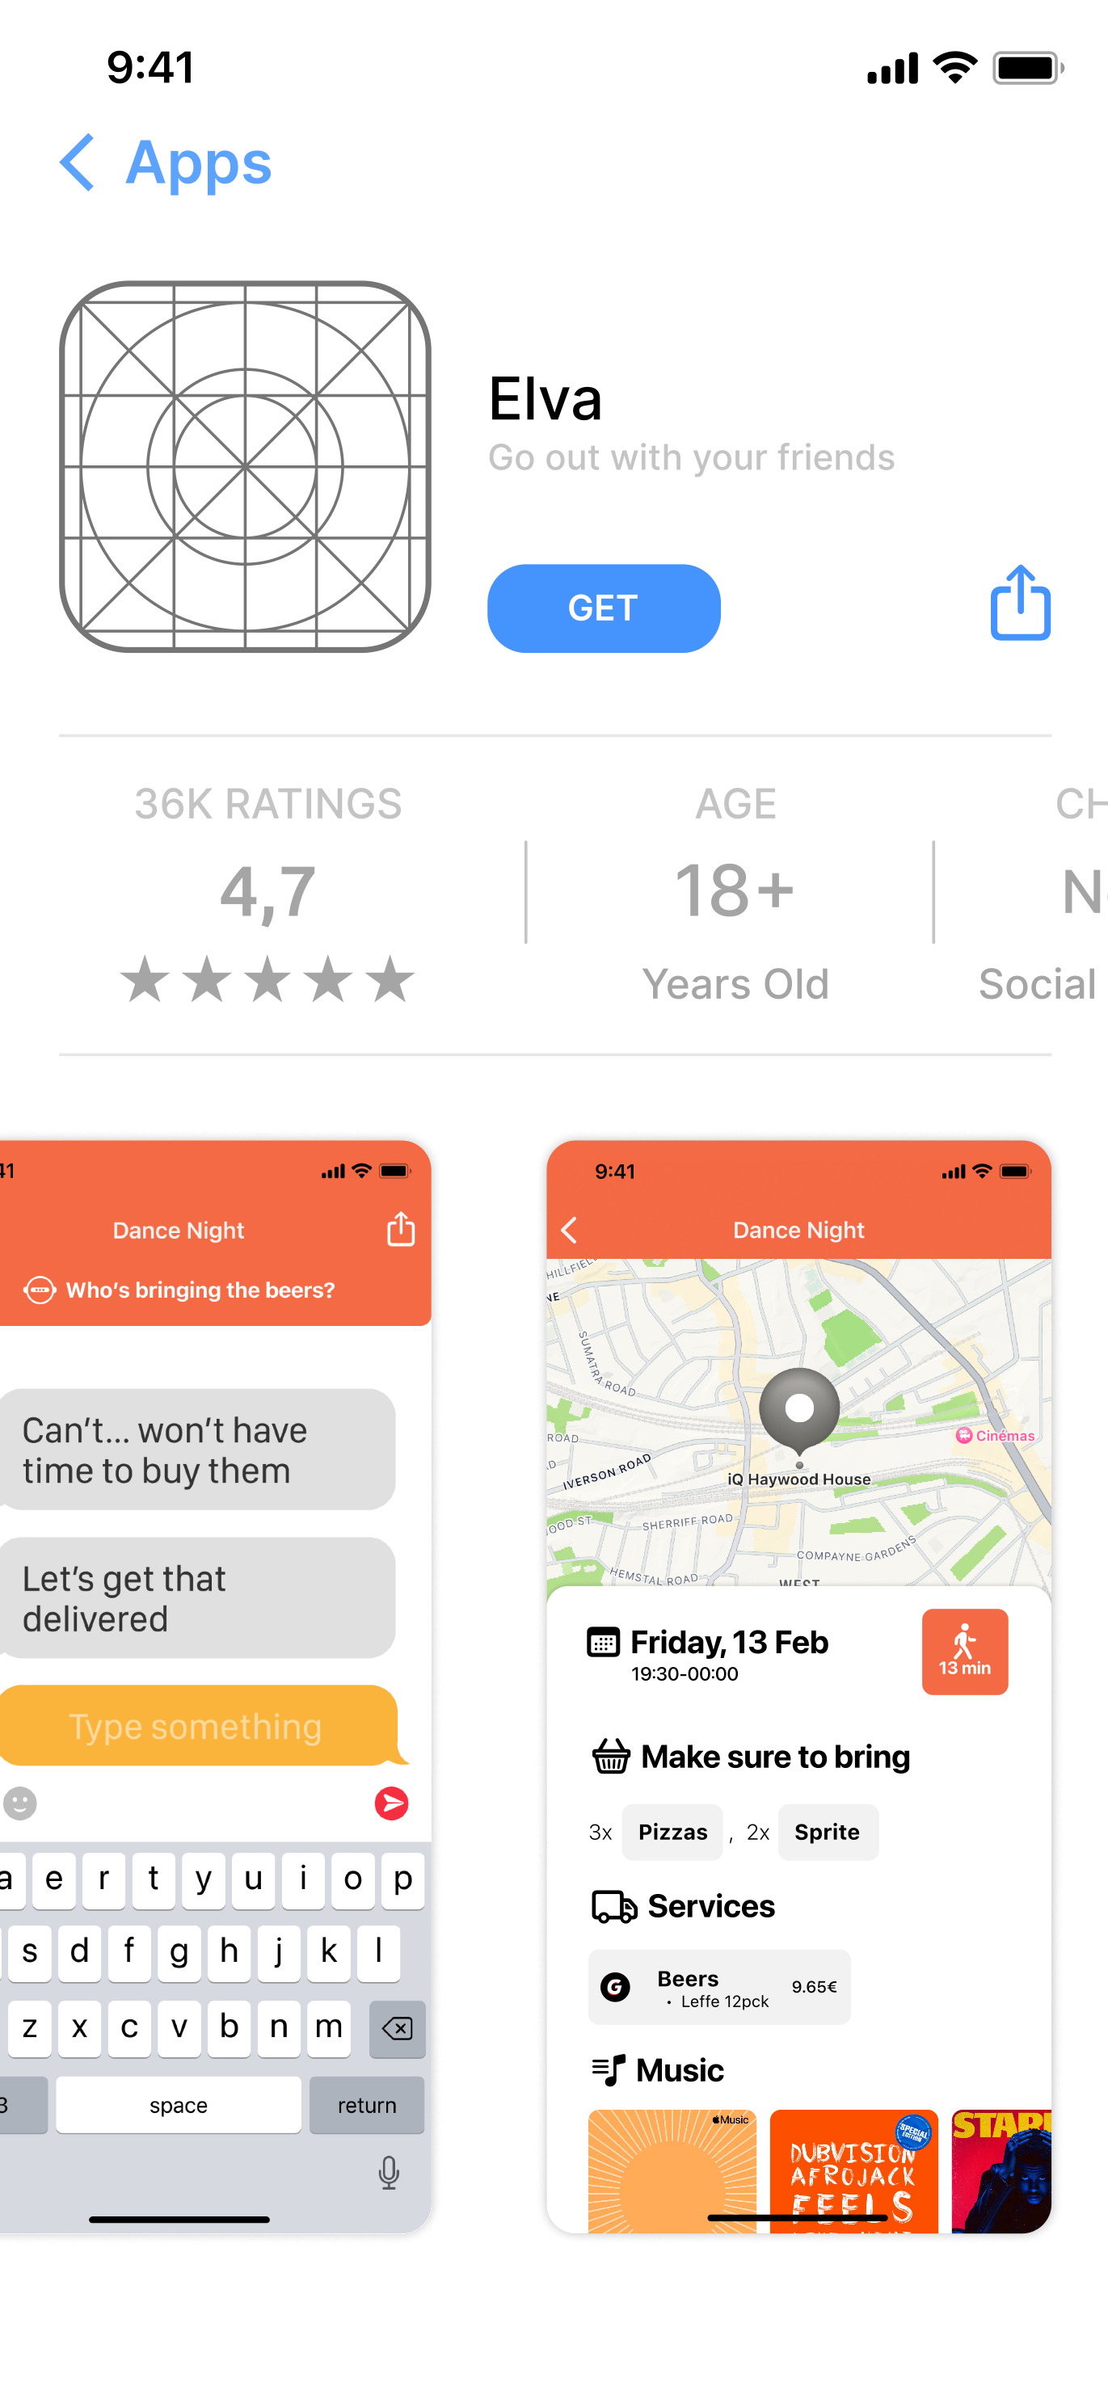

Introducing Elva

Slide 9
Introducing Elva

Slide 10
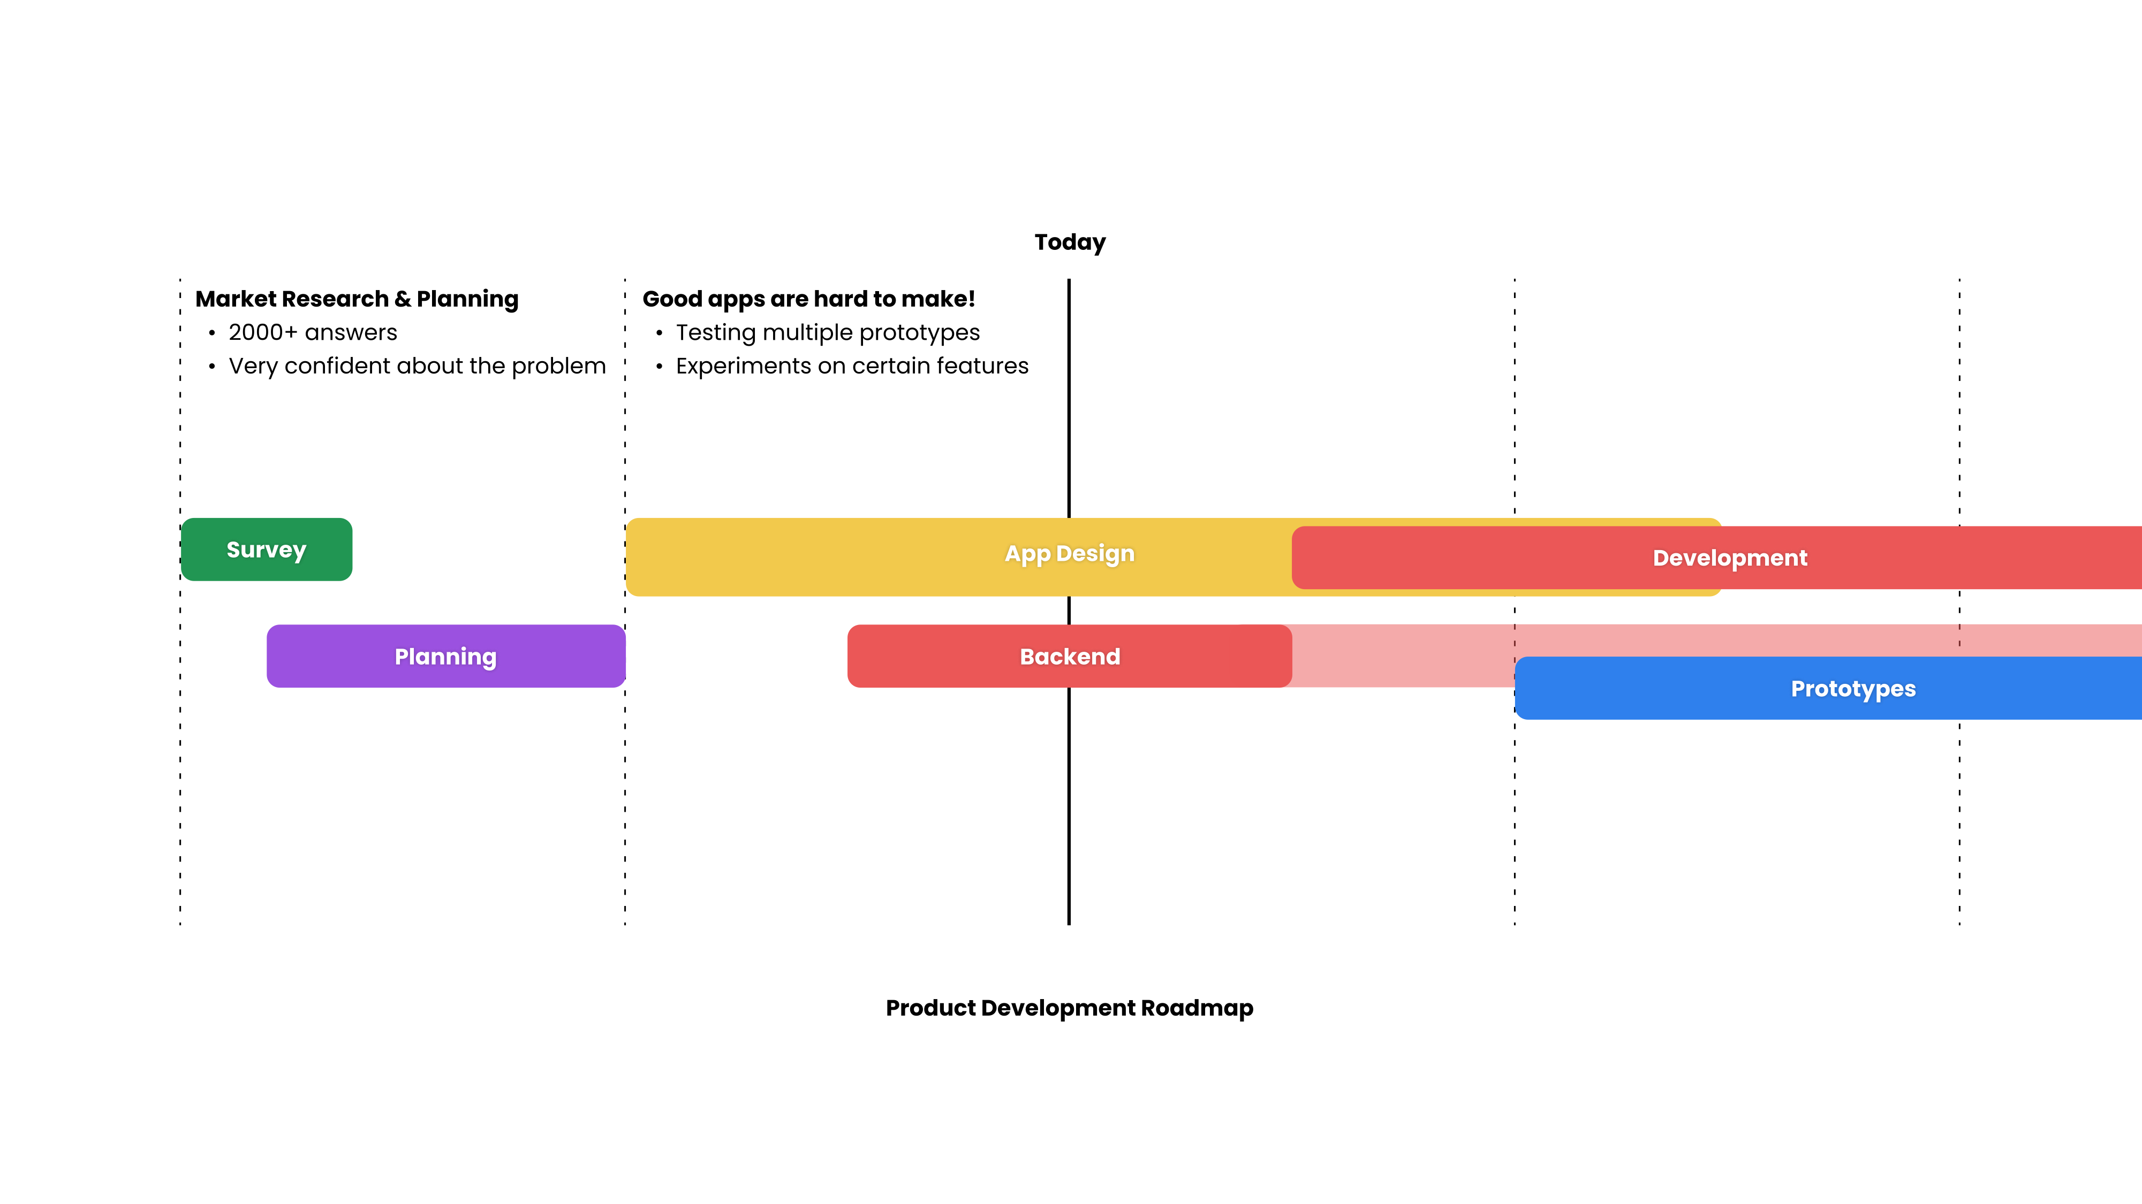
Traction & Progress

Slide 11
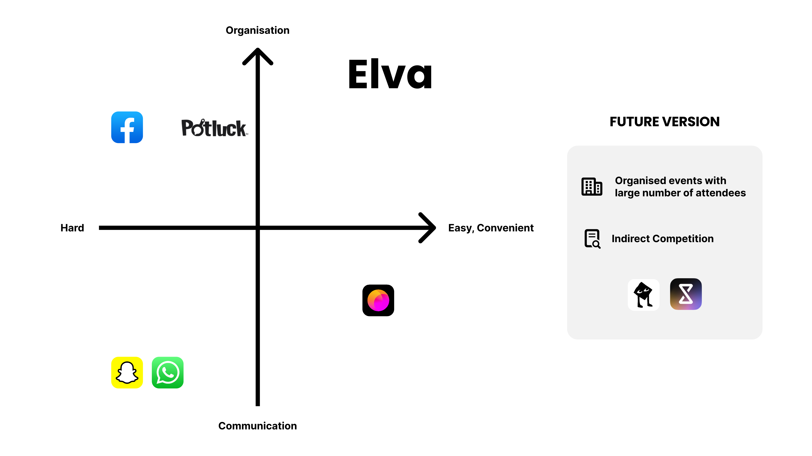

Slide 12
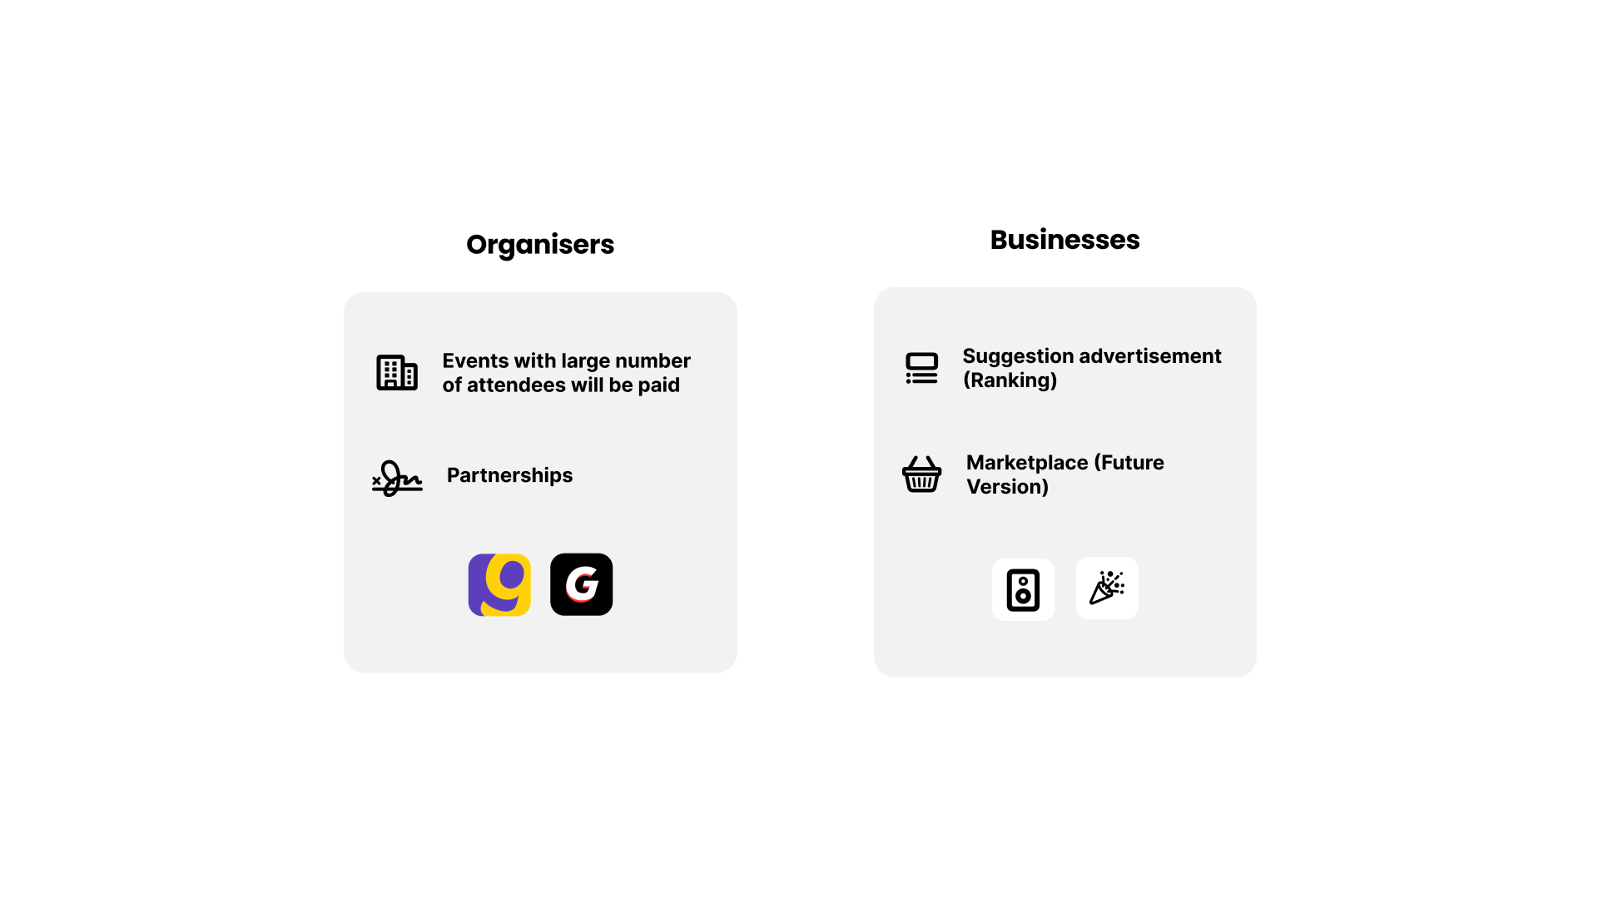
How Elva makes money

Slide 13
To succeed, we need:
Business partners to help expand our offers to other markets.
50k+ $ SAFE investment
Hire contractors to speed up the product development
Help to build the infrastructure (gives us flexibility)
Give us a 12-month runway
Marketing

Slide 14

Thank you!

