Slide 1










Arthur Guiot · Victor Collot
Notes:
Hi everyone, my name is Arthur, my name is Victor and we are both from France.
We started Elva 3 month ago, because as a college student, I receive this message every week, and what always follows is the chaos in the group chat.
And what we found very interesting, is that at a macro scale, this seems to be caused by not one but two problems

Slide 2


Online Connections, Offline Loneliness
60%
18-34 say that they often feel lonely.
Notes:
First, young generations tends to develop more and more social anxiety which lead to loneliness. This seems to be correlated with social medias.

Slide 3
Messaging just doesn’t work
Online Connections, Offline Loneliness
60%
18-34 say that they often feel lonely.
Notes:
In fact, in the UK, 60% of 18-34 say they often feel lonely, a problem that could easily be fixed by seeing your friends more often.

Slide 4
Messaging just doesn’t work
Notes:
The second problem is that messaging doesn’t help, because most of the time bad communication is the reason why people struggle organising.
And if you don’t have the super motivated extrovert in the group that will do everything, it just doesn’t work. It’s really a problem I think everyone can relate to, yet it remains unsolved.
And because it’s hard for that one extrovert guy to be in every group chat in the world,

Slide 5

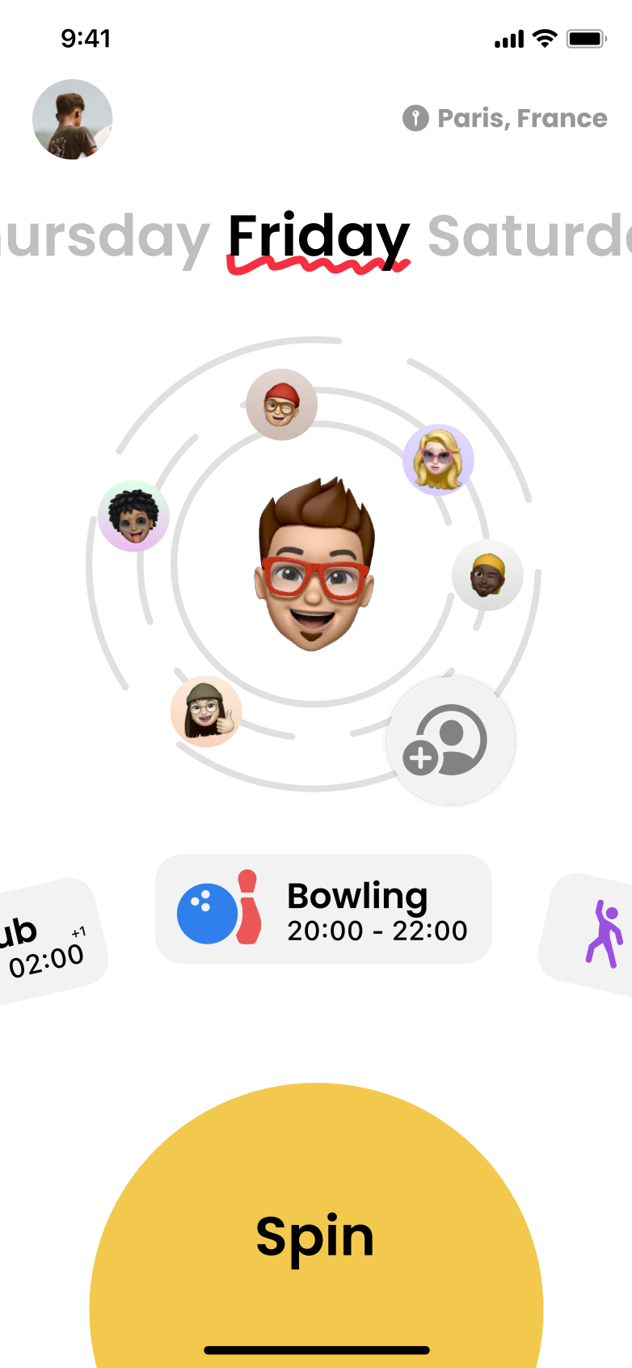
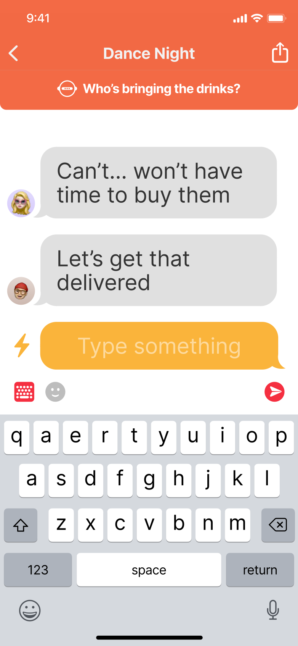
Messaging just doesn’t work
Notes:
We decided to start Elva. Elva is a messaging app that does the hard work for you.
The first thing you see when opening the app is who within your friends are available, and it suggest ideas of what you can do together.

Slide 6
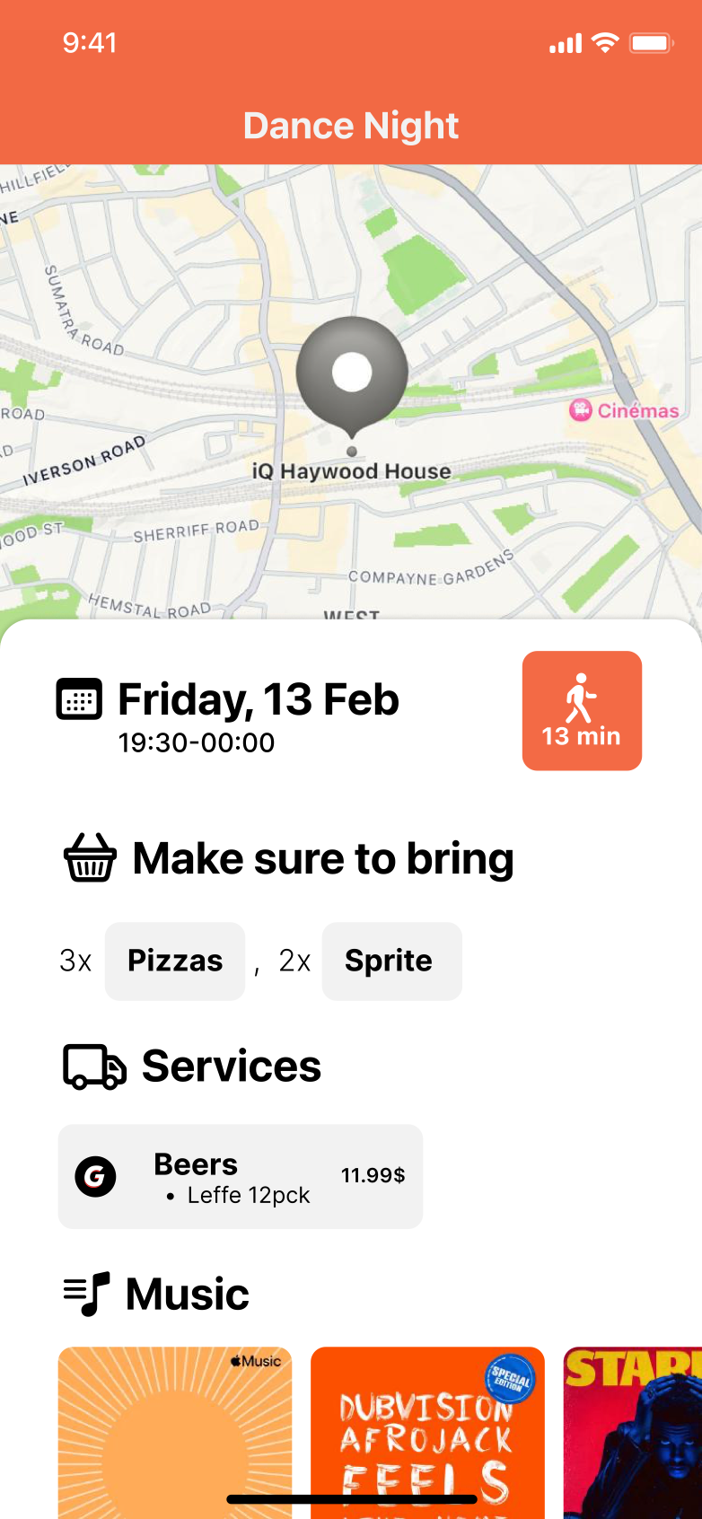
Notes:
But what really makes the difference is that Elva guides the conversation by asking questions. These questions are personalised and they don’t interrupt the conversation.

Slide 7
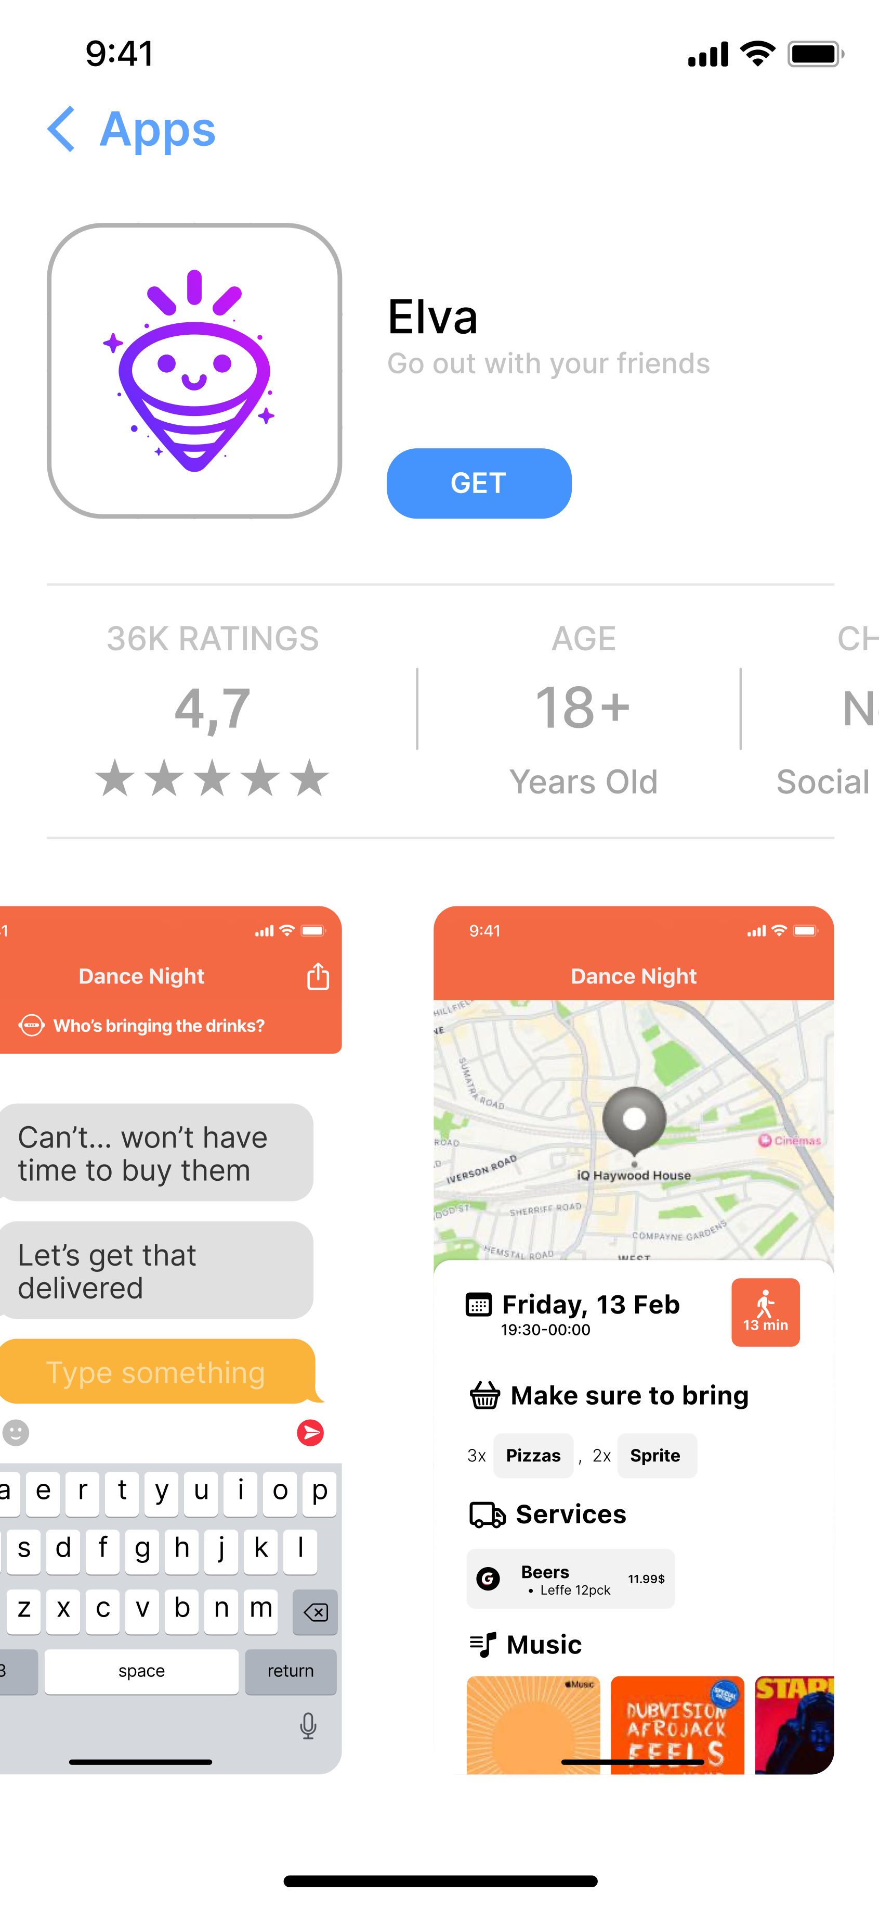

Notes:
After, we’re able, from the conversation data, to extract details and display them in a structured and efficient way so that everyone is on the wavelength.

Slide 8
Notes:
But the best feature of our app is that it will be 100% free, with no in-app purchase.

Slide 9

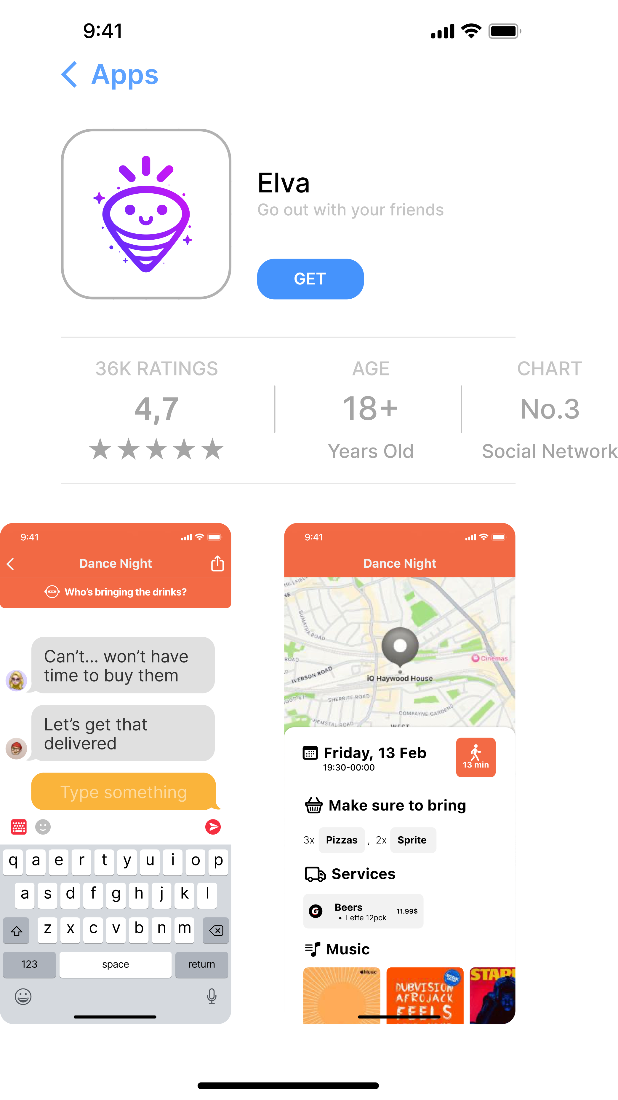
Notes:
→ Marketplace, activity ideas and even party games
→ No forms, easy event sharing, just a very very good interface that guides users into making or joining events
→ Elva summarises automatically important information so that everyone is on the same wavelength

Slide 10
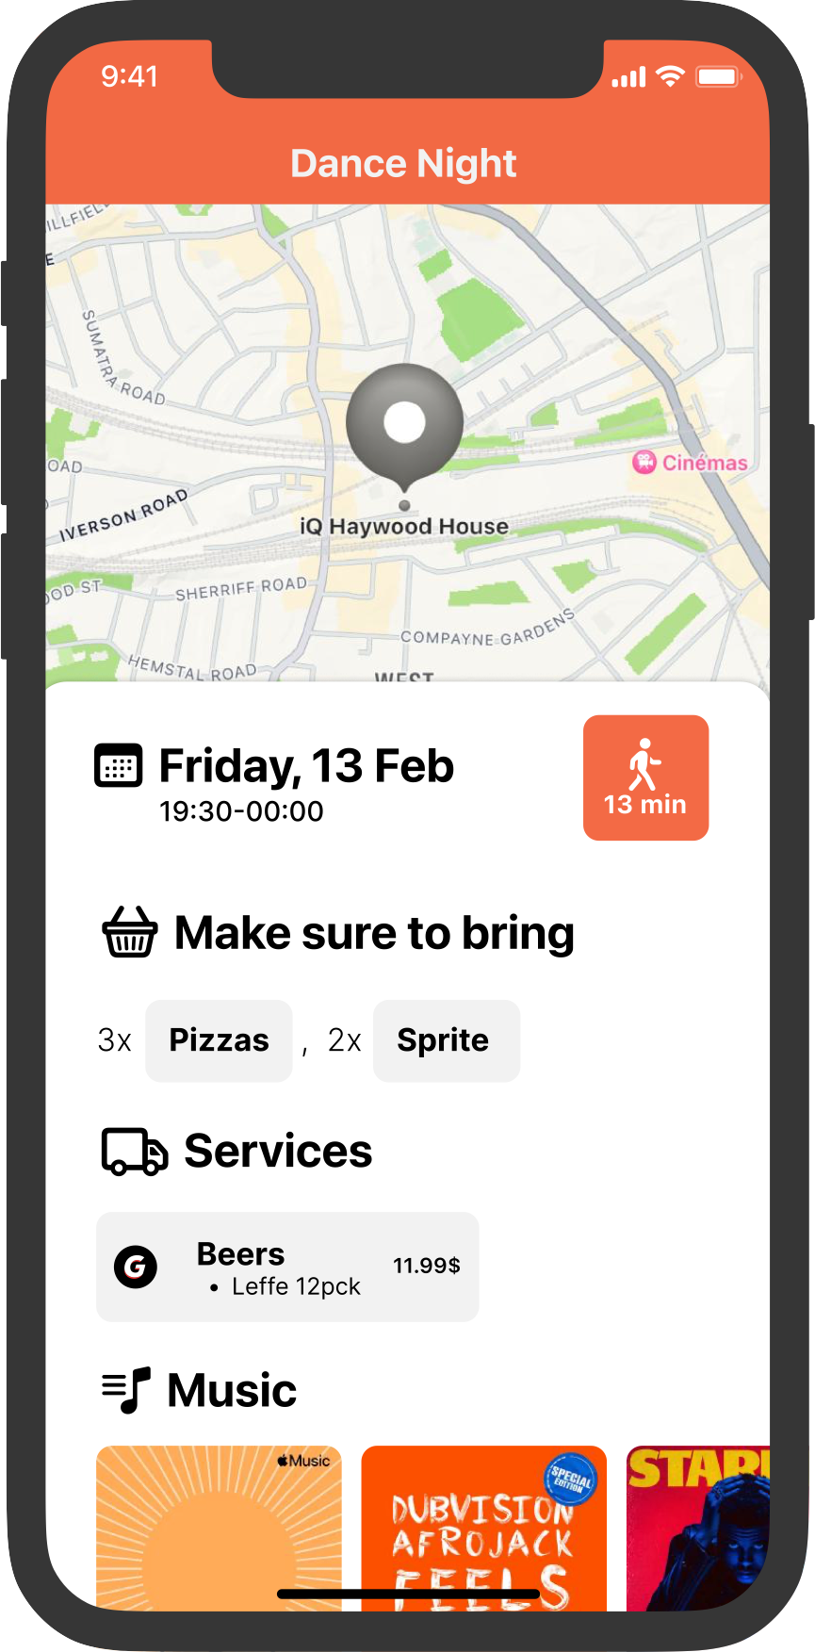
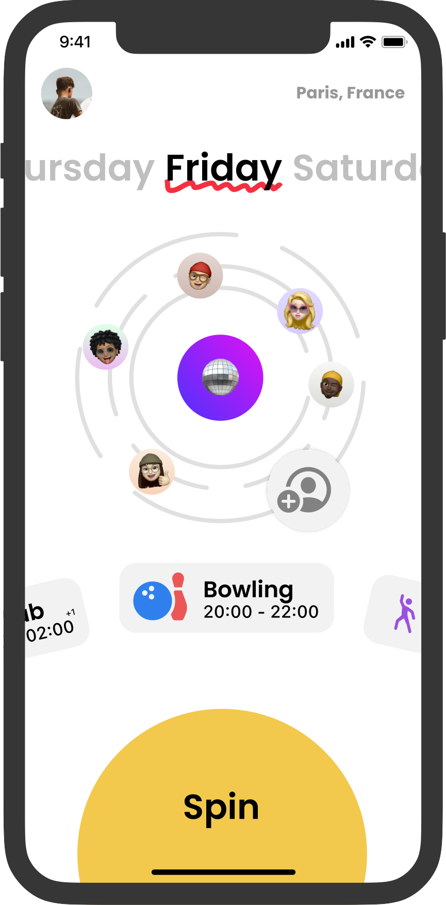
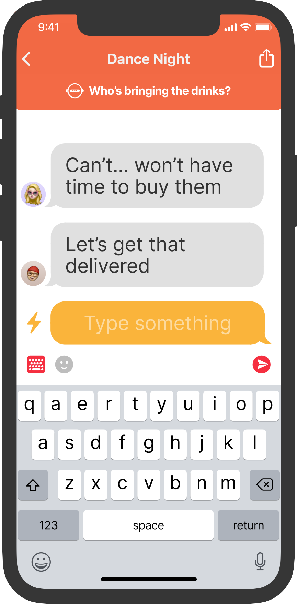
The ultimate party planning tool
Notes:
→ Marketplace, activity ideas and even party games
→ No forms, easy event sharing, just a very very good interface that guides users into making or joining events
→ Elva summarises automatically important information so that everyone is on the same wavelength

Slide 11
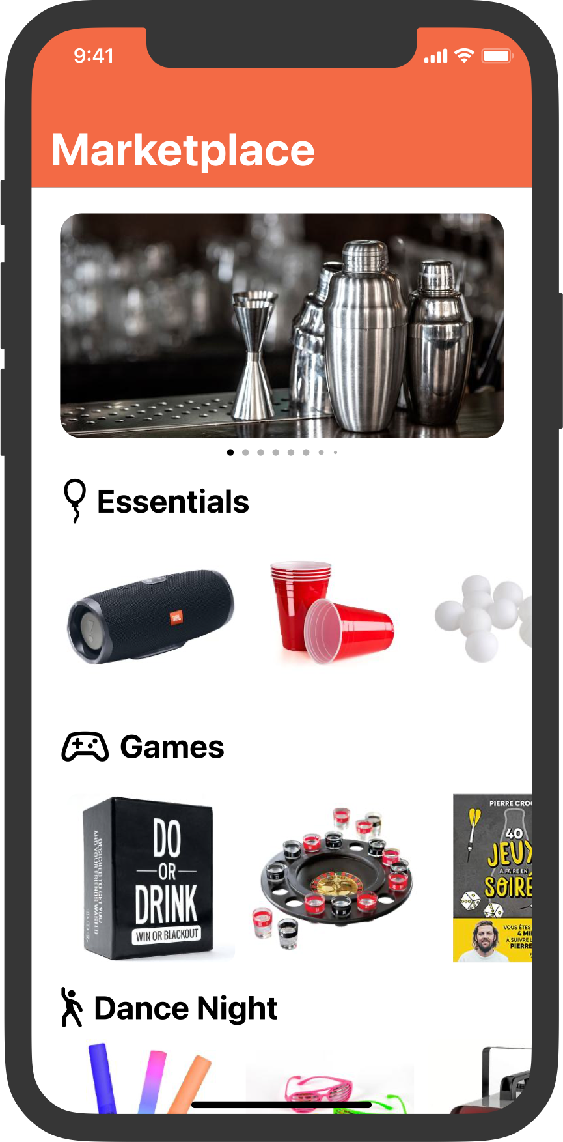
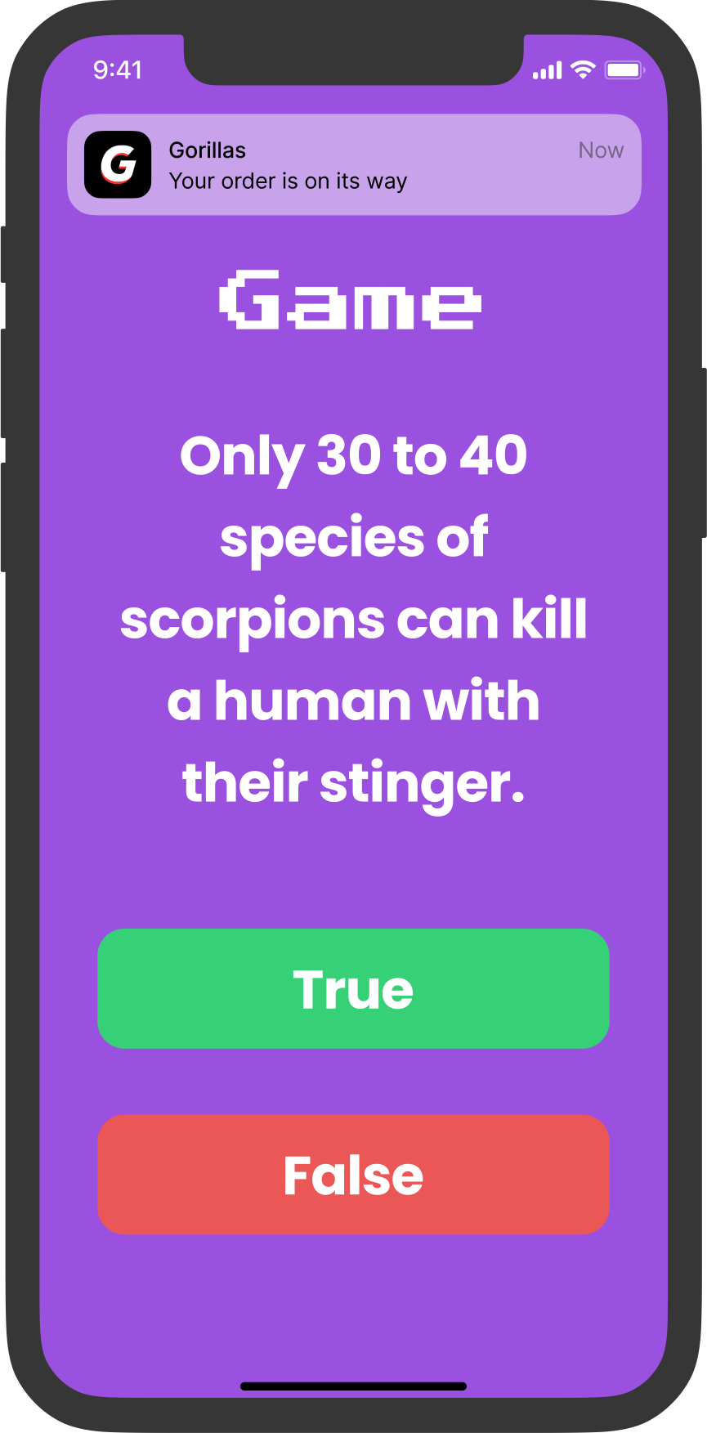
The ultimate party planning tool
Notes:
This is how we’re going to defeat social anxiety and fix messaging for young generations.

Slide 12
…with even more to help you make the switch
Notes:
And as part of our user acquisition strategy, because we know as a social app, having no users at the beginning makes it hard to start strong, we’ll be offering a marketplace and a party game mode to make our ecosystem stronger.

Slide 13
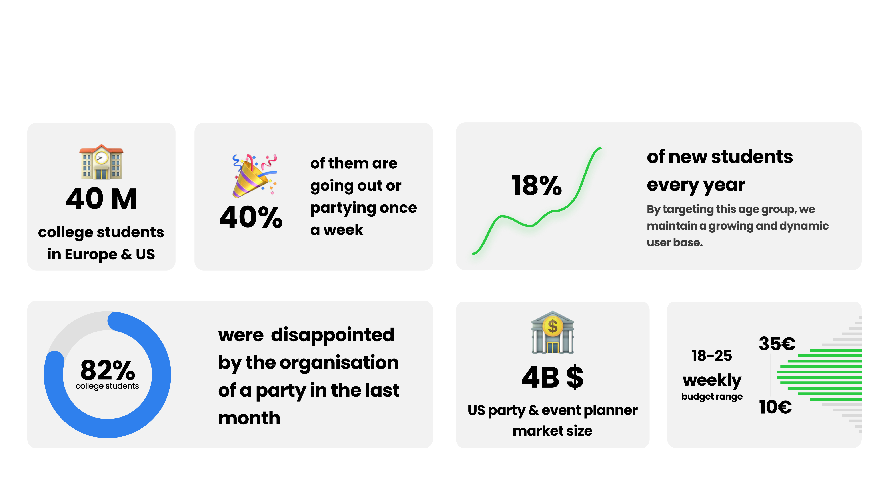
Target Market
Notes:
As you probably understood our target audience is college students.
Although we want Elva to be for everyone, targeting this big but easily identifiable group will help us to grow fast.
This is also the segment that is the most likely to benefit from Elva.

Slide 14
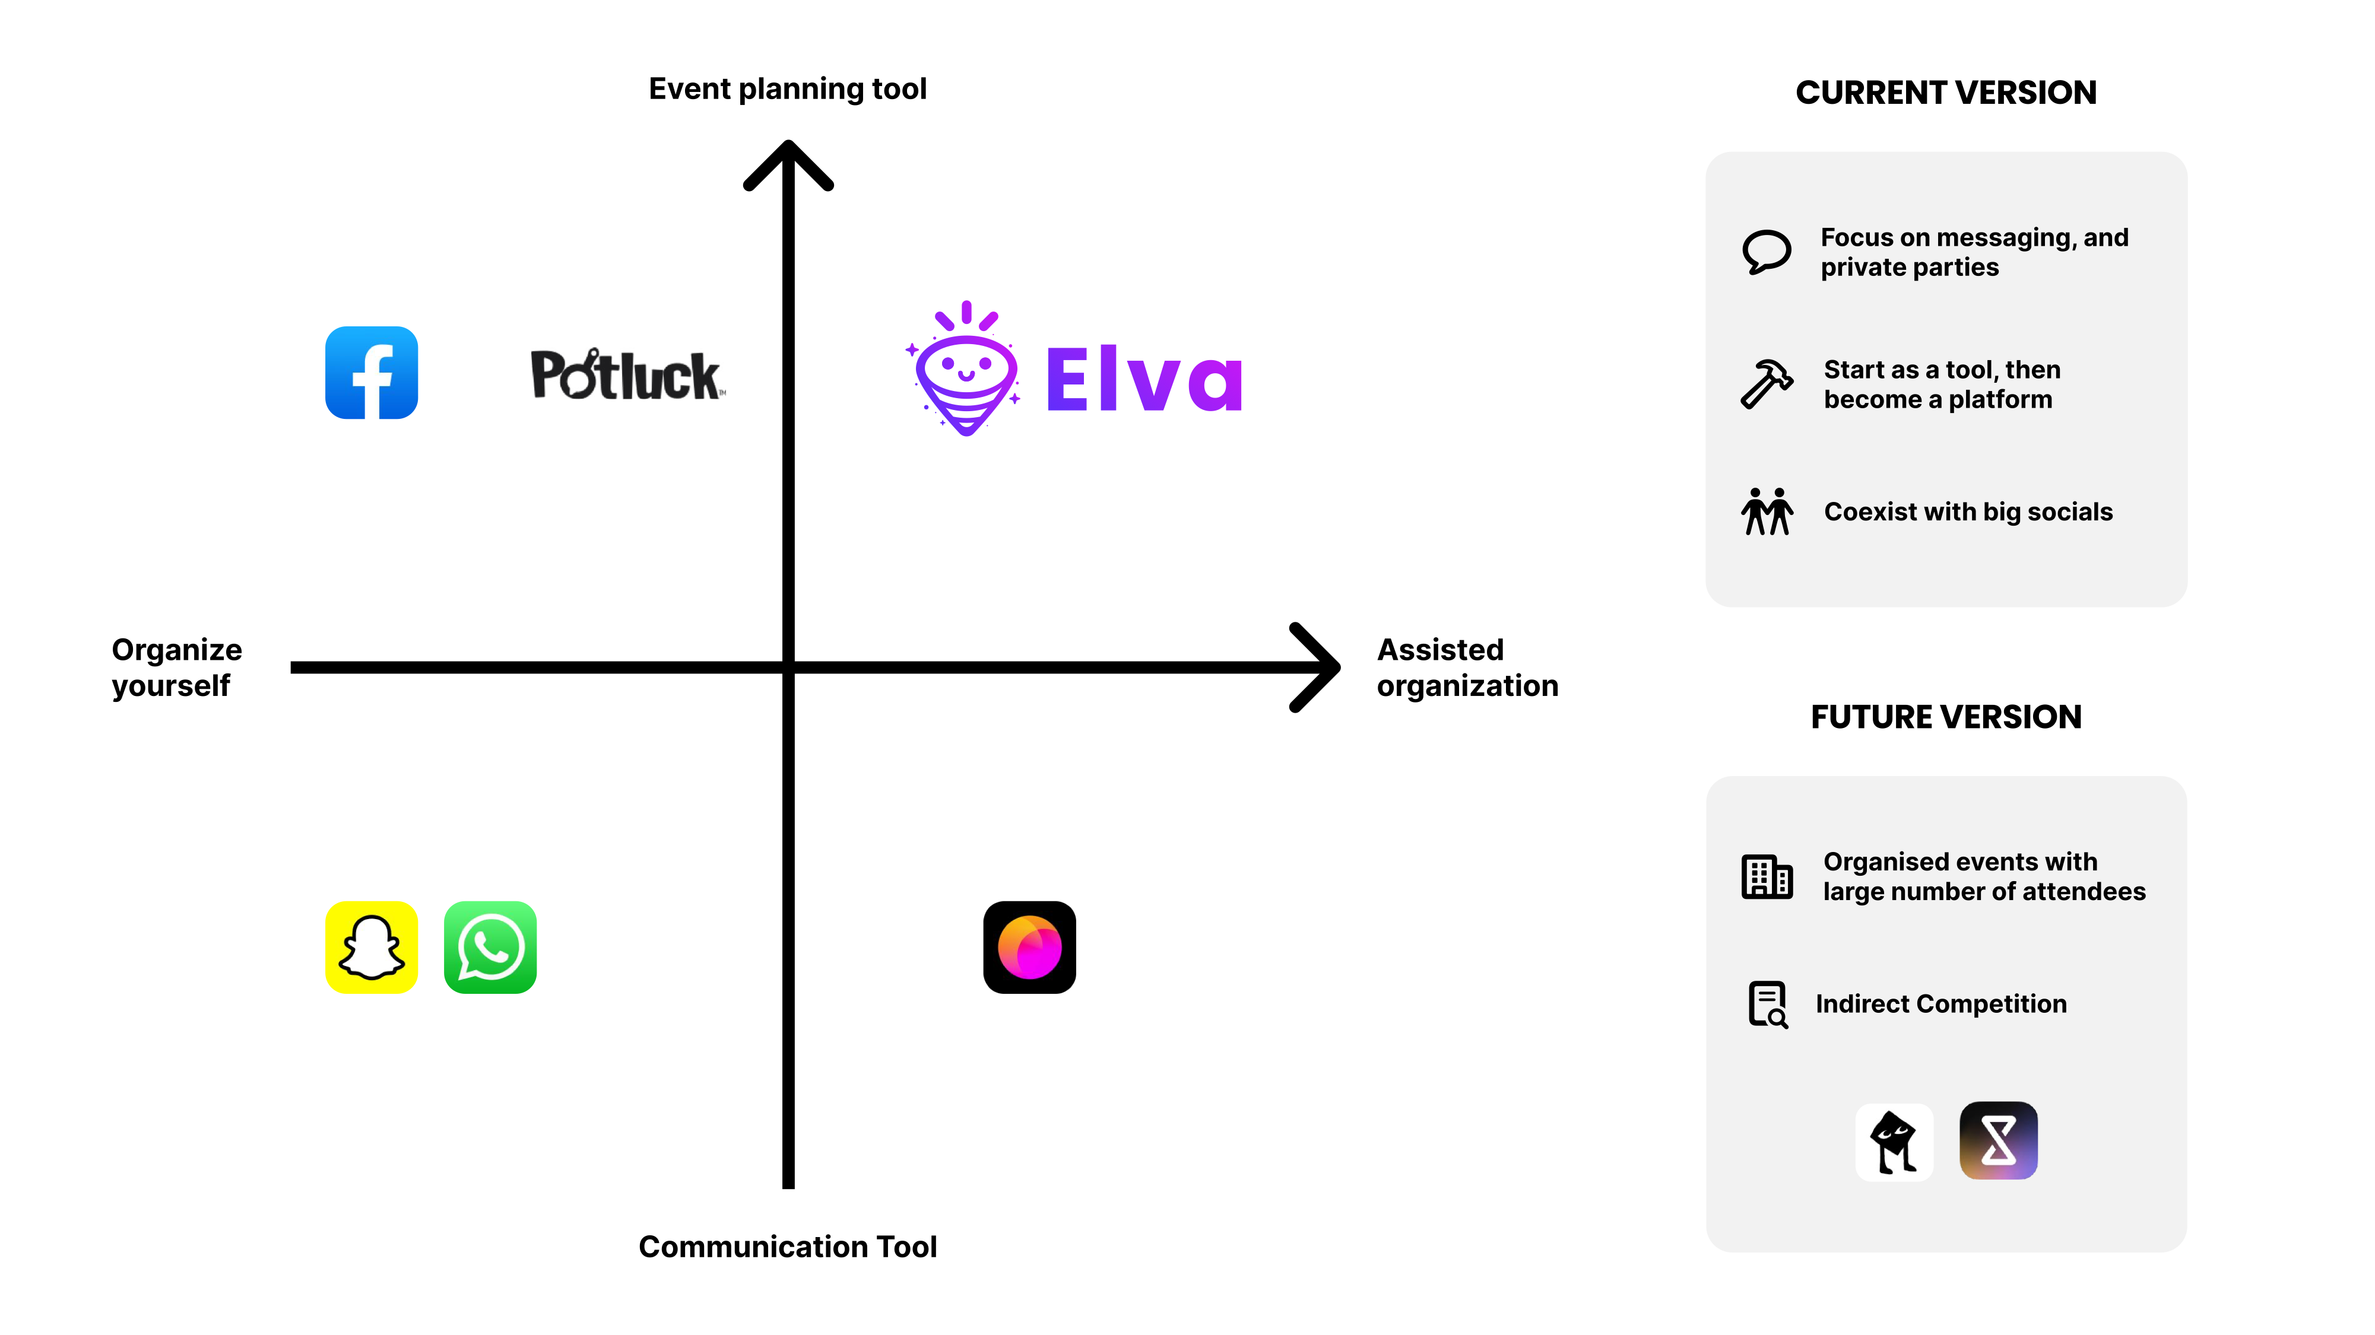
Notes:
As you can see, we are perfectly positioned because we focus on small and private parties.
Elva is the only messaging app capable of self-organizing events.
We don’t want to beat the big socials but to coexist with them.

Slide 15
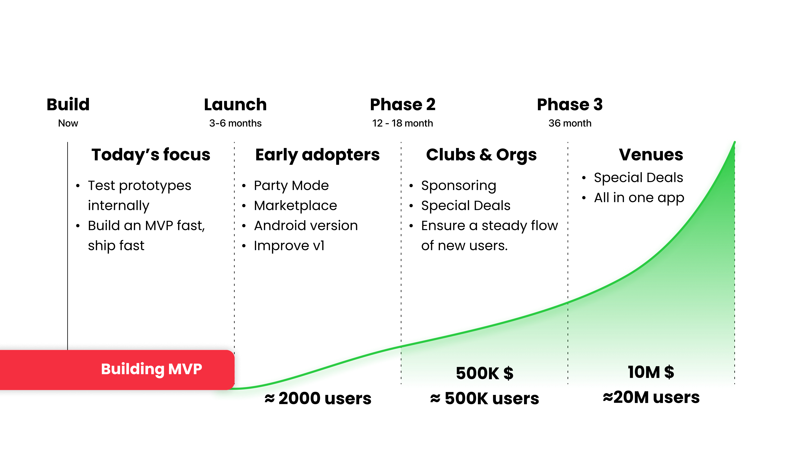
Go to market
Notes:
At the moment, we are finishing our MVP, and we will launch Elva very soon!
Then we will get our first users by word of mouth.
Next we will start sponsoring clubs and on campus organisations.
And finally, our plan is to not only focus on parties but to expand to any social activity

Slide 16
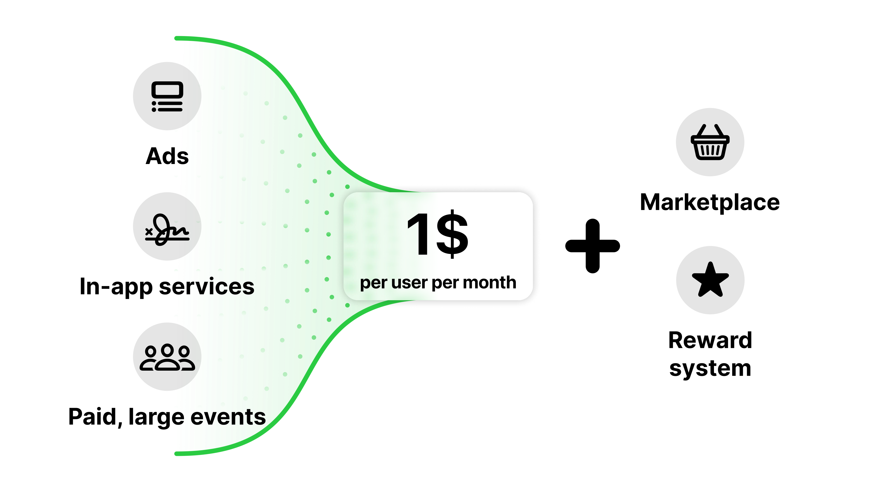
Business Model
Notes:
Our business model is build around two kinds of customers.
The left side shows the large part of our customers who will use the classic features and we expect to get 1$ per user per month using this model.
And we will have more "active" users that will use the marketplace.
This model will easily double or triple our incomes, if not more in the short term.

Slide 17
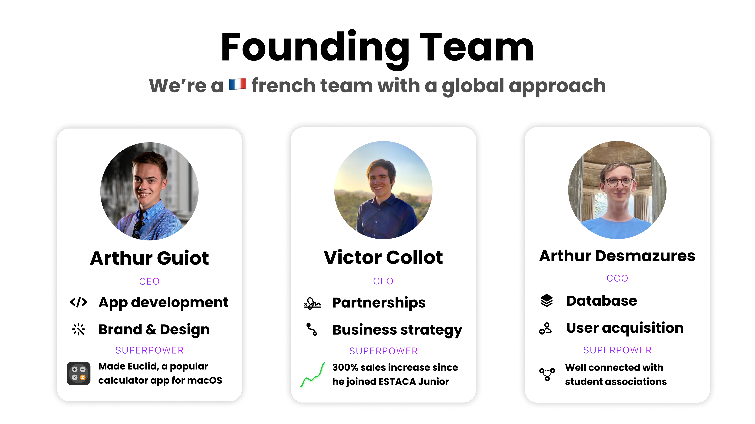
Notes:
Finally, we just wanted to take a moment to talk about us. We’re a team of three engineers, all from France, but we got to live around the world and develop each unique skills and assets ranging from Arthur being able to reach instantly thousands of customers through his student association network, to Victor who can build and execute winning strategies, and me who got 7 years experience building apps.

Slide 18
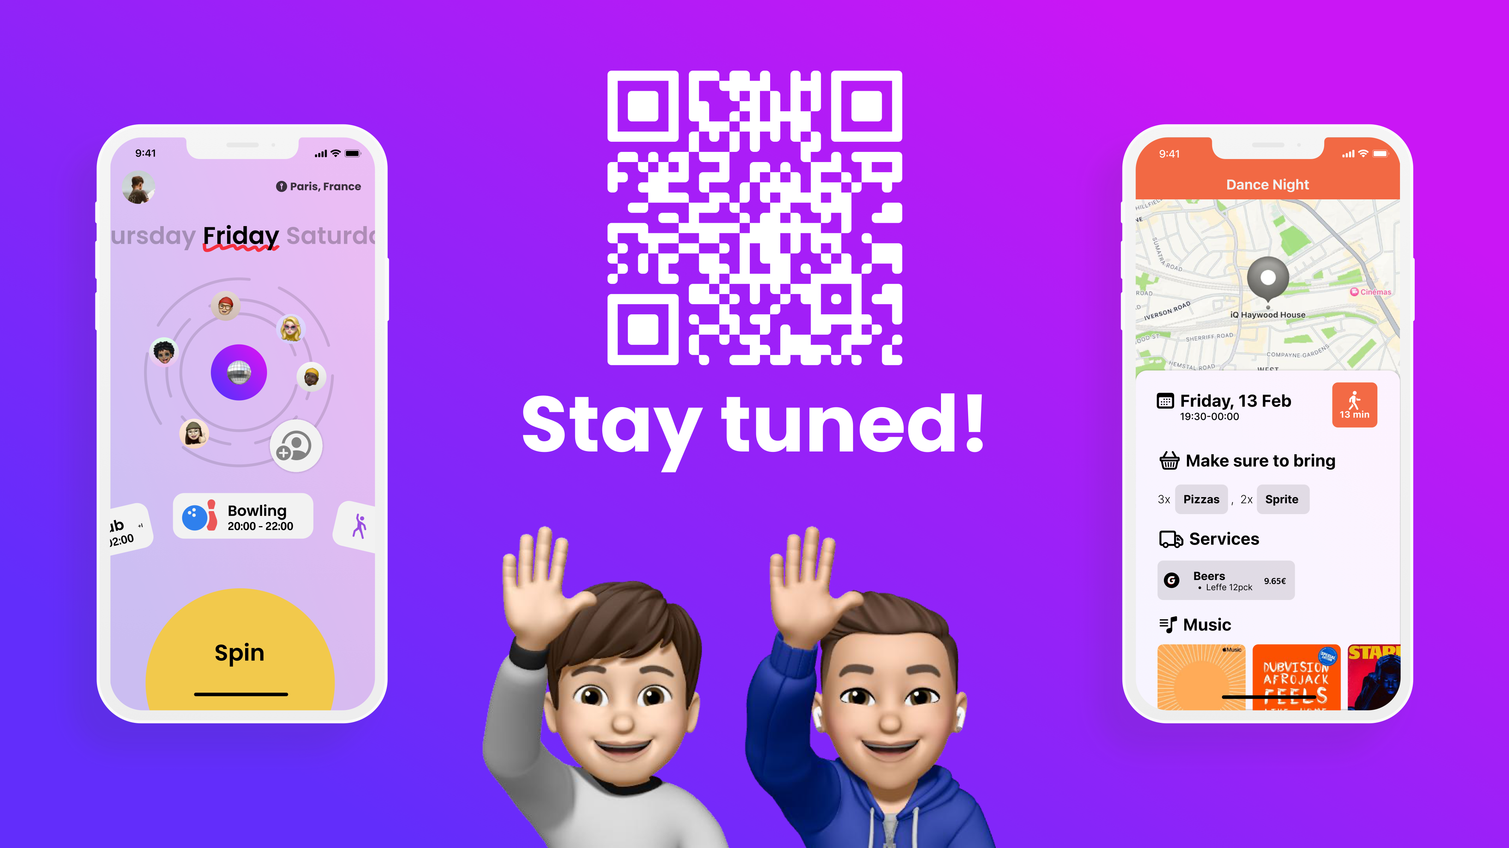
Notes:
Thank you so much for listening to us. There is a lot more about Elva, so please visit our website at elva.social or come talk with us at our booth SS23.

